Slide 2
Wyckoff Environmental Commission/Green Team March 26, 2025
Waste Reduction
Recycling
Other Options

Slide 3
The Three R’s

Slide 4
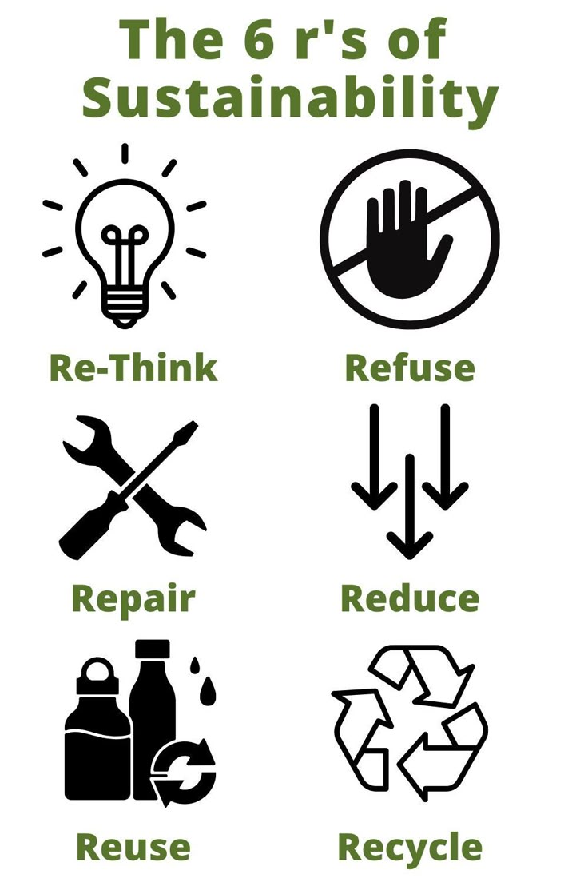
The Other R’s!
Rethink
Repair
Refuse

Slide 5
Rethink
This is primarily focused on changing business behaviors
Rethink" means shifting away from the assumption that growth must come at the expense of environmental health. Instead, businesses can innovate by developing products and services that minimize resource use, embrace circular economy principles, and deliver value without unnecessary consumption.

Slide 6
Repair
Exactly what it sounds like. Can you repair something that’s broken or worn rather than throwing it out and buying a replacement?
It’s a balance between the cost of the repair, the ease of executing the repair, and the cost of a replacement item.
Some examples are:
Resoling shoes
Sewing torn seams in clothing
Sharpening dull knives and garden tools
Several towns in Bergen County have implemented annual repair cafés for small appliances.

Slide 7
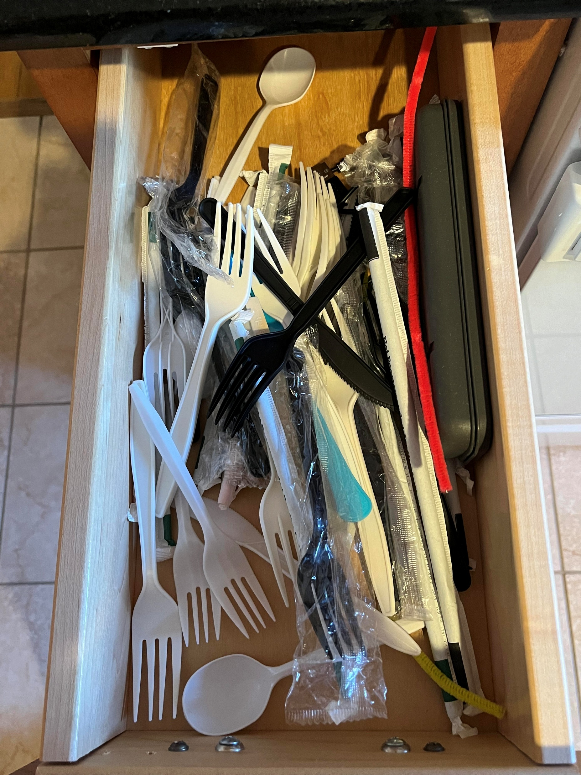
Refuse
Actively choosing not to purchase or consume unnecessary or unsustainable products. Who else has a drawer like this at home?

Slide 8
Refuse!
One example is an initiative called Skip the Stuff – when getting takeout or bringing home leftovers, simply decline the plastic utensils, straws and condiments if you don’t need them.

Slide 9
Refuse!
Another is to get off of junk mail lists at https://dmachoice.org/
Stop pre-screened insurance and credit card solicitations at https://www.optoutprescreen.com/
Refusing plastic or paper bags in situations where reusable bags are not required is another example of what individuals can do. Reusable bags are not just for grocery shopping, but also for produce, the pharmacy and many other retail locations.

Slide 10
Reduce and Reuse
Minimize waste generation by using resources efficiently and consuming less. This means making conscious choices to buy less, choose products with less packaging, and avoid unnecessary consumption.
Give items a second life by finding new uses for them instead of discarding them. Examples include using reusable shopping bags, food containers, or repurposing old items for different purposes.
Reusable bags can be donated at drop off locations or food banks near you.
There are a number of ways to resell or repurpose/gift items you no longer need (e.g., buy nothing groups on Facebook, online Marketplace).

Slide 11
Recycling in Wyckoff
Wyckoff offers several methods to participate in recycling
Dual Stream Curbside Pickup
Recycling Depot
Periodic Events
Wyckoff residents can also participate in Bergen County hazardous waste collections
Visit bcua.org
Certain business will accept select materials for recycling.
For e.g. Staples in Ramsey collects single use batteries

Slide 12
Recycle Coach
Recycle Coach is a great tool to help remind you of the schedule for pickup and special events.
You can also query Recycle Coach about how to handle specific items (i.e., trash or recycling)
You can even take a photo of your trash/recyclable item to see where it goes.

Slide 13
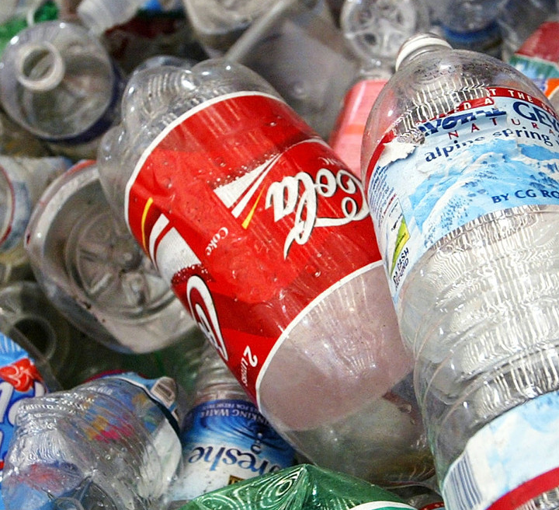
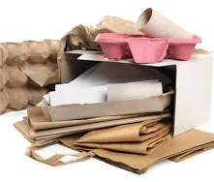
Curbside Recycling
Alternate weekly pickup
Week 1:
Paper
Corrugated cardboard
No shredded paper
Week 2:
Plastics 1,2, and 5
Metal cans
Glass containers

Slide 14
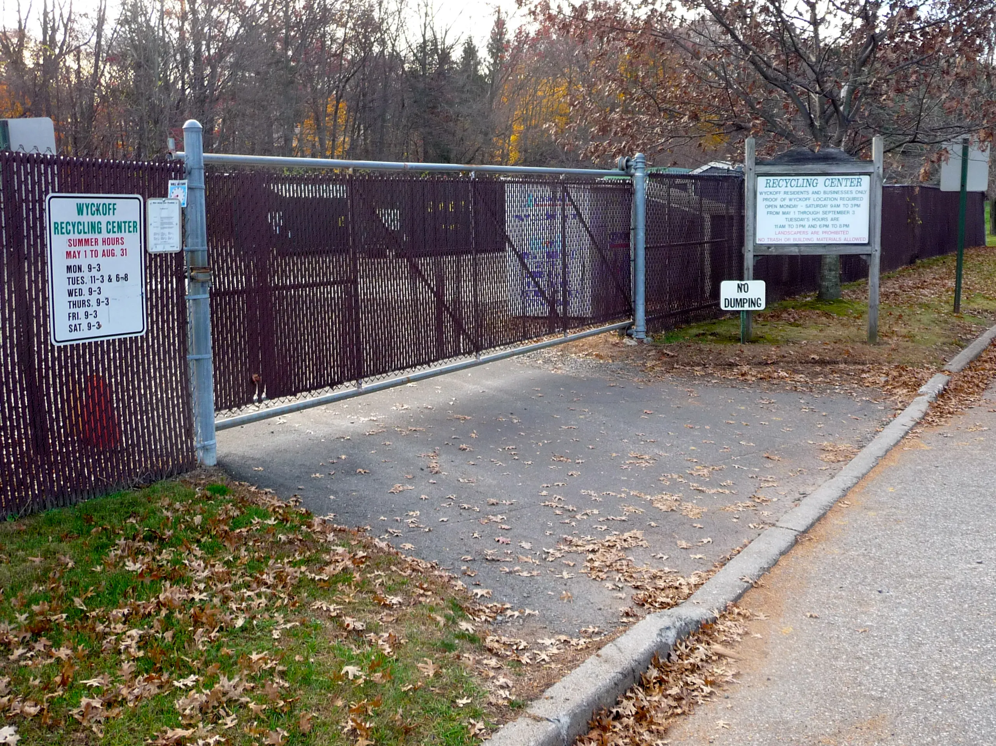
Recycling Center
Located at 476 West Main Street
Accepts multiple types of recycled materials including the curbside items:
Scrap Metal
EPS (Styrofoam)
Secure Paper Shredding Bins
Books
Clothing
Consumer Electronics
Yard Waste and Grass Clippings

Slide 15
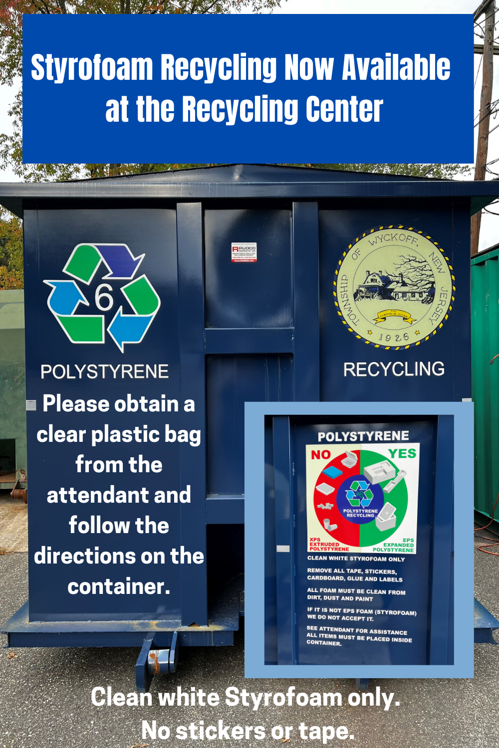
Recycling Center
Both Styrofoam and paper shredding are new additions to the recycling center and over time will replace one time collection events.
Styrofoam (EPS) must be white and clean with all tape removed.
No food containers or packing peanuts
Paper can be placed into the secure shredding bins.

Slide 16
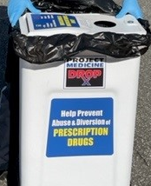
Medication Disposal
There is a medication disposal bin located at Wyckoff Police Headquarters
Guidelines for medication disposal are found at: https://www.wyckoffnj.gov/drug-abuse-education/pages/medication-disposal
Local pharmacies may also have facilities to collection expired or unused medication.

Slide 17
Disposal of large white goods
Wyckoff will pick up large metal items like appliances, pick up scheduling required.

Slide 18
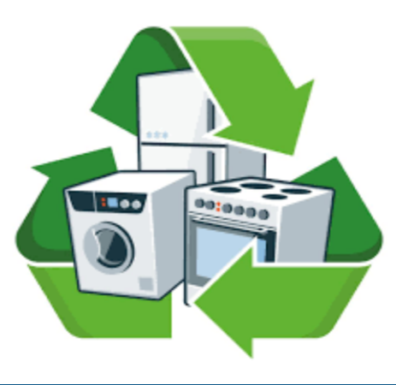
Disposal of large white goods
PSE&G will also pick up appliances and may offer rebates.

Slide 19
Wyckoff Library
The Wyckoff Public Library accepts book donations on Thursdays.
Donations may be placed under the stairwell
Please donate only:
Newer books in good condition
Fiction and nonfiction
Children’s books
DVDs & CDs
Paperbacks especially needed
No VHS tapes, cassettes, technical books, encyclopedias, textbooks, or magazines
Books not accepted may be placed in the book bin at the Wyckoff Recycling Center

Slide 20
Composting
And last but far from least, food waste is the greatest source of residential waste.
Backyard composting is the ultimate recycling action!
The Wyckoff Environmental Commission has held annual composting workshops.
Wyckoff sells the Earth Machine Composter at cost to residents ($70).
To order, email wec@wyckoffnj.gov.

Slide 21
Final Message
Please recycle and take other actions to reduce waste, however,
When in doubt, check the Recycle Coach App for What Goes Where. If it’s not there, throw it out!
THANK YOU!

