Slide 2
Solar Energy - Should I Consider It?
Mary Ann Crawford, DVM
Wednesday, March 26, 2025
7PM
Notes:
#1. Good evening! I am a retired veterinarian (38 years at the OAH) and wanted to share my family’s journey as we decided to have solar panels installed at our home. ….. I am not a solar engineer - but I have had a wonderful experience with solar panels - My GOAL this evening is to share my experience with my fellow Wyckoff residents and provide some tips that may help expedite the process.

Slide 3
Our road to help slow climate change…
-Improved recycling practices
-hybrid cars
-planting trees
-switch from gas to battery charged lawn equipment
-composting
Share information with neighbors and friends
-other ways to slow climate change?----->
Notes:
# 2. I want to make a positive impact on the environment. I am 43 years old having my first baby - I am especially concerned for his upcoming world! …………. MAIN WAY TO SLOW CLIMATE CHANGE IS TO QUIT BURNING FOSSIL FUELS
(thanks to Denise Capparelli’s web site and Ben’s upcoming presentation, we will all be much better at it!)

Slide 4
What else can we do to cut down on the use of fossil fuels?
WOW!! PSE and G has a smart clean energy program for the residential customer!
96% of the energy is produced through wind and solar energy, 4% through the “dirty” energy - of coal and gas
Notes:
#3……….. You call and sign up in 2 minutes!. Lots of promotions - gift cards special initial rates, etc.

Slide 5
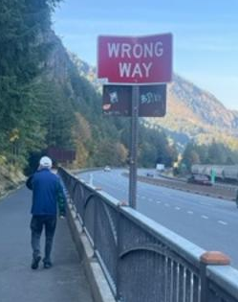
.
The fees of this Smart Clean Choice energy program kept rising. Smart Energy added between $150 to almost $300 EVERY month to the electric bill.
We were using more and more electricity (summer) and the cost was getting higher and higher…
“Clean energy is expensive”. Its not going to save you money immediately, but it will lower greenhouse gases!! What should I do??
EEEEK!
Notes:
#4. Remember renewable energy costs more than polluting energy - its not going to save you money immediately, but it will lower greenhouse gases which is sooo important!

Slide 6
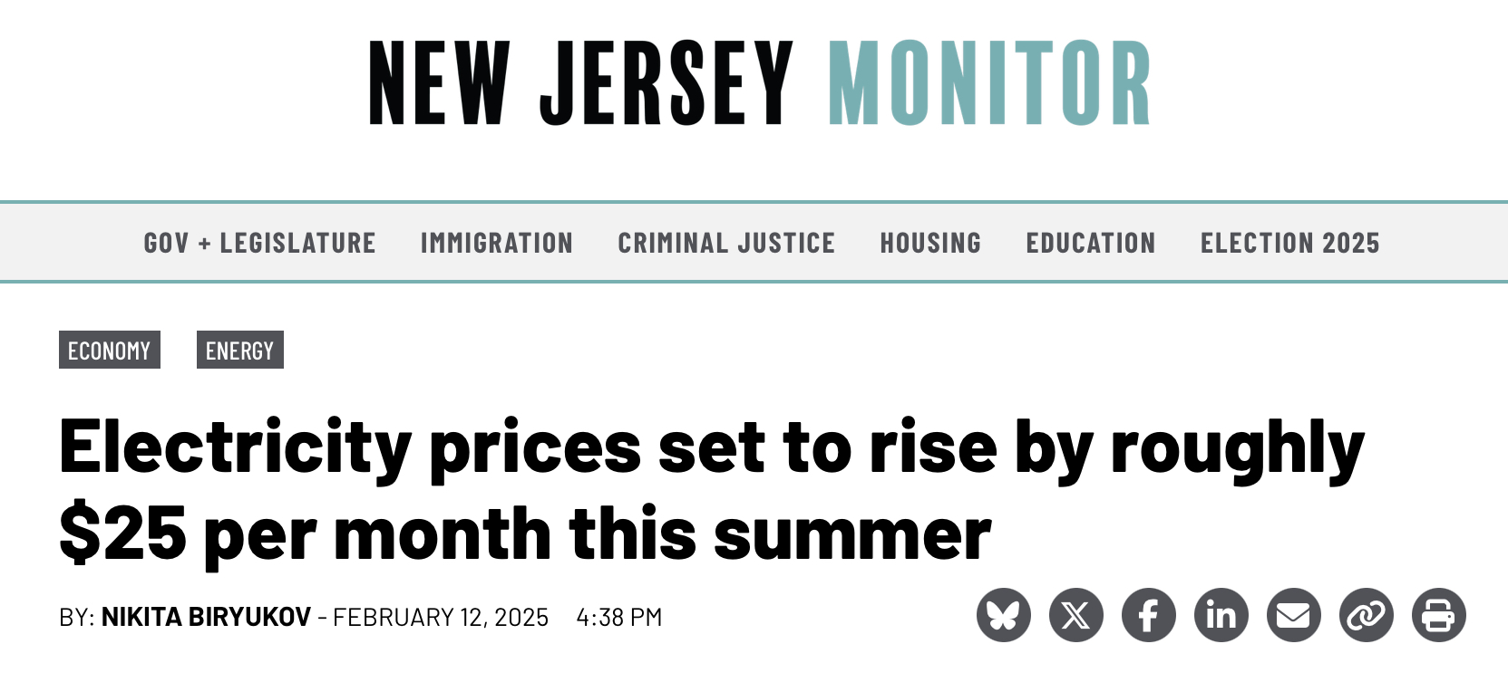
What led me to Solar?
Tried to use PSE&G’s ”Clean Energy Program,” which had 96% of your power come from renewable resources
But was adding $250/month to our electric bill
Wanted to make a positive impact on the environment while being cost effective, especially with rising electricity prices
Notes:
5. To review this - what led me to solar…. Look at the current information for 2025…

Slide 7
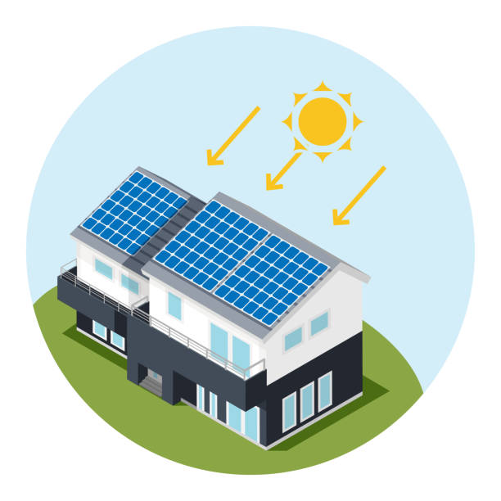
A friend and a neighbor installed solar panels last year and are very pleased they took the leap!
Both were paying less than $10 /month to their utility companies for their electricity
Both are contributing to their nests of energy and storing it till it's needed. Both are generating SREC’s.
It will likely take 4-6 years for them to recoup their original investments, but there is virtually NO utility bills for electricity in the meantime..
“OK I’M INTERESTED!!!!”
Notes:
#6. …Starting my investigation…..Let’s have a show of hands - who currently has solar panels, who is curious about solar panels..
Estimate that it will take about 4- 6 years to recoup the initial investment. ECONOMIC BENEFITS ARE BIG!
Back to the picture….Direction of the sun - will it work? The direction of the sun hitting the roof, you just don’t want it to ALL be facing NORTH (Mine is facing NW). Most solar companies will let you know pretty quickly through a site survey if your house is a candidate for solar panels for no charge, so don’t sweat it. Check it out….

Slide 8
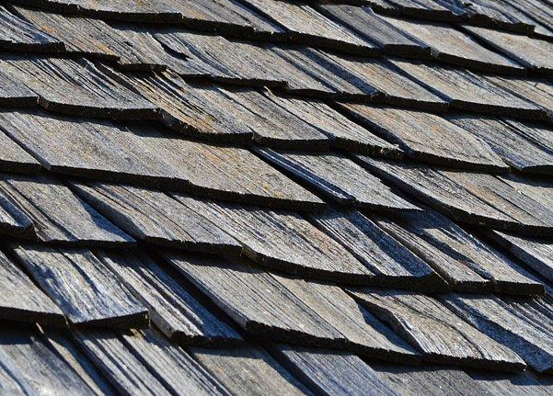
Inspections start with the property, then the roof and attic….
Both could need work …… very important to address any issues now before the panels get placed.
Notes:
#7. First assess the property and the roof - extensive inspection by the solar company (s). My Massachusetts friend had to have re-inforcements or slats placed under her roof from the attic side. My neighbor’s entire roof needed to be replaced - that was done at same time as solar panels.

Slide 9
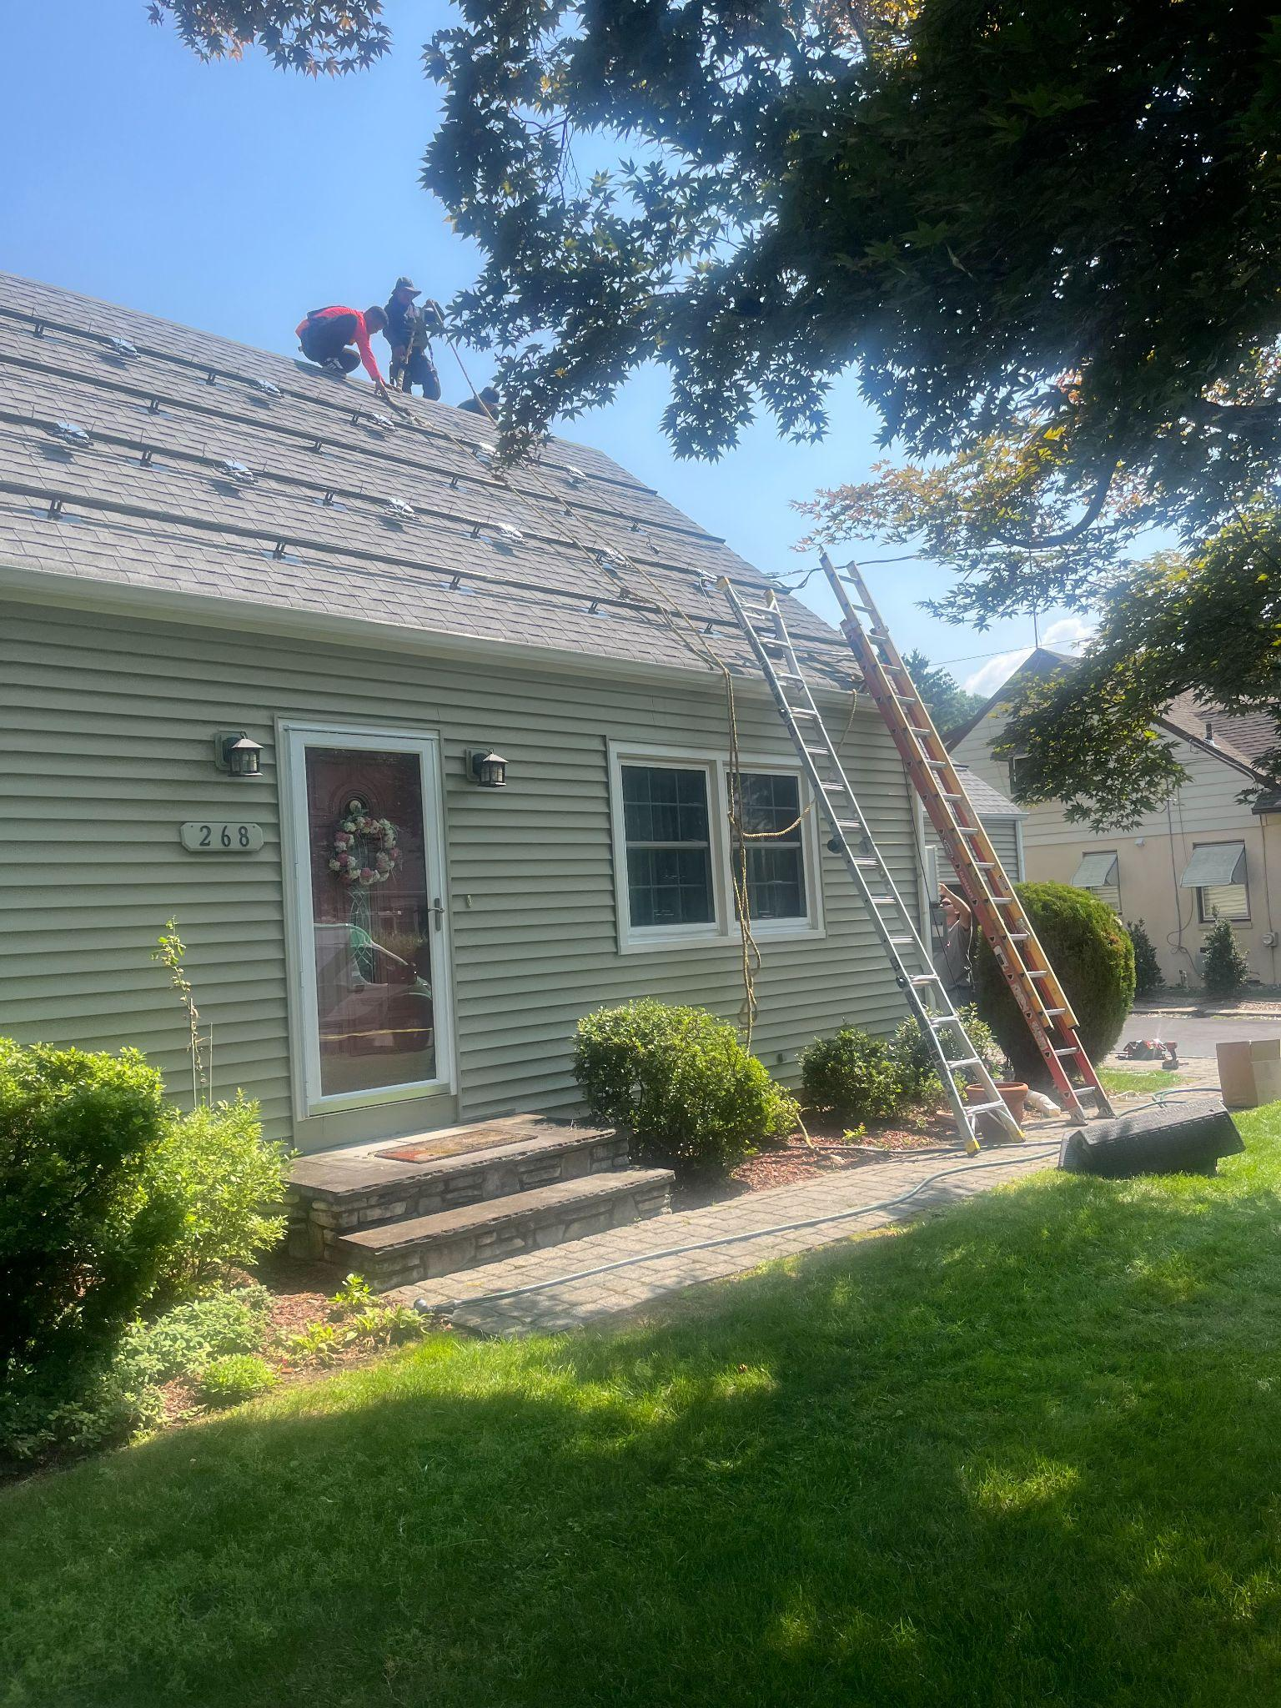
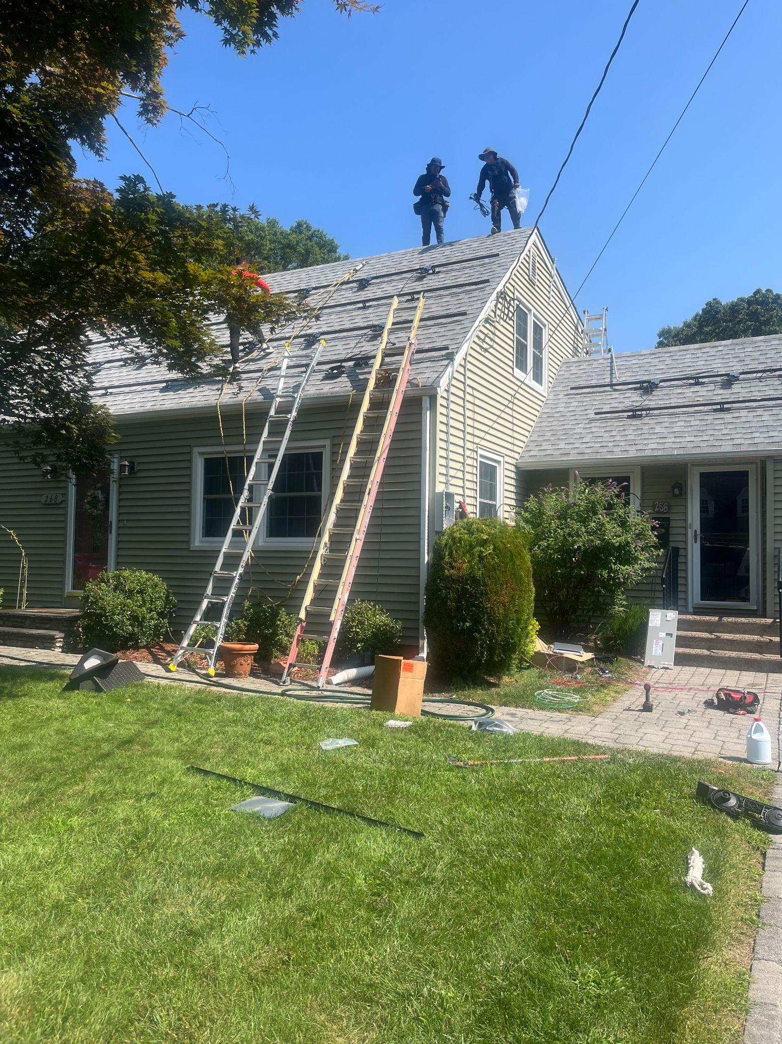
before
Notes:
#8. Assuming that all goes well, next is creating the project and ordering the parts. This is day one for installing racks, it will be another day for panels to be installed. Number and placement is decided by the solar engineers based on where the maximum efficiency occurs. (Also, Look at the shade on the left picture… I did not want to cut down the tree - DID’T HAVE TO)
Duration of the whole process till you get hooked up?- estimate 3-5 mos until the system goes live.

Slide 10
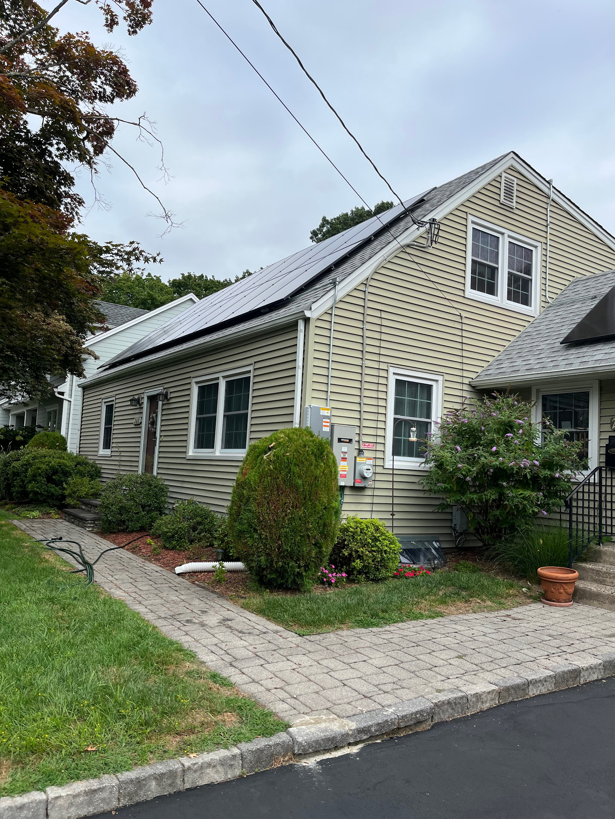
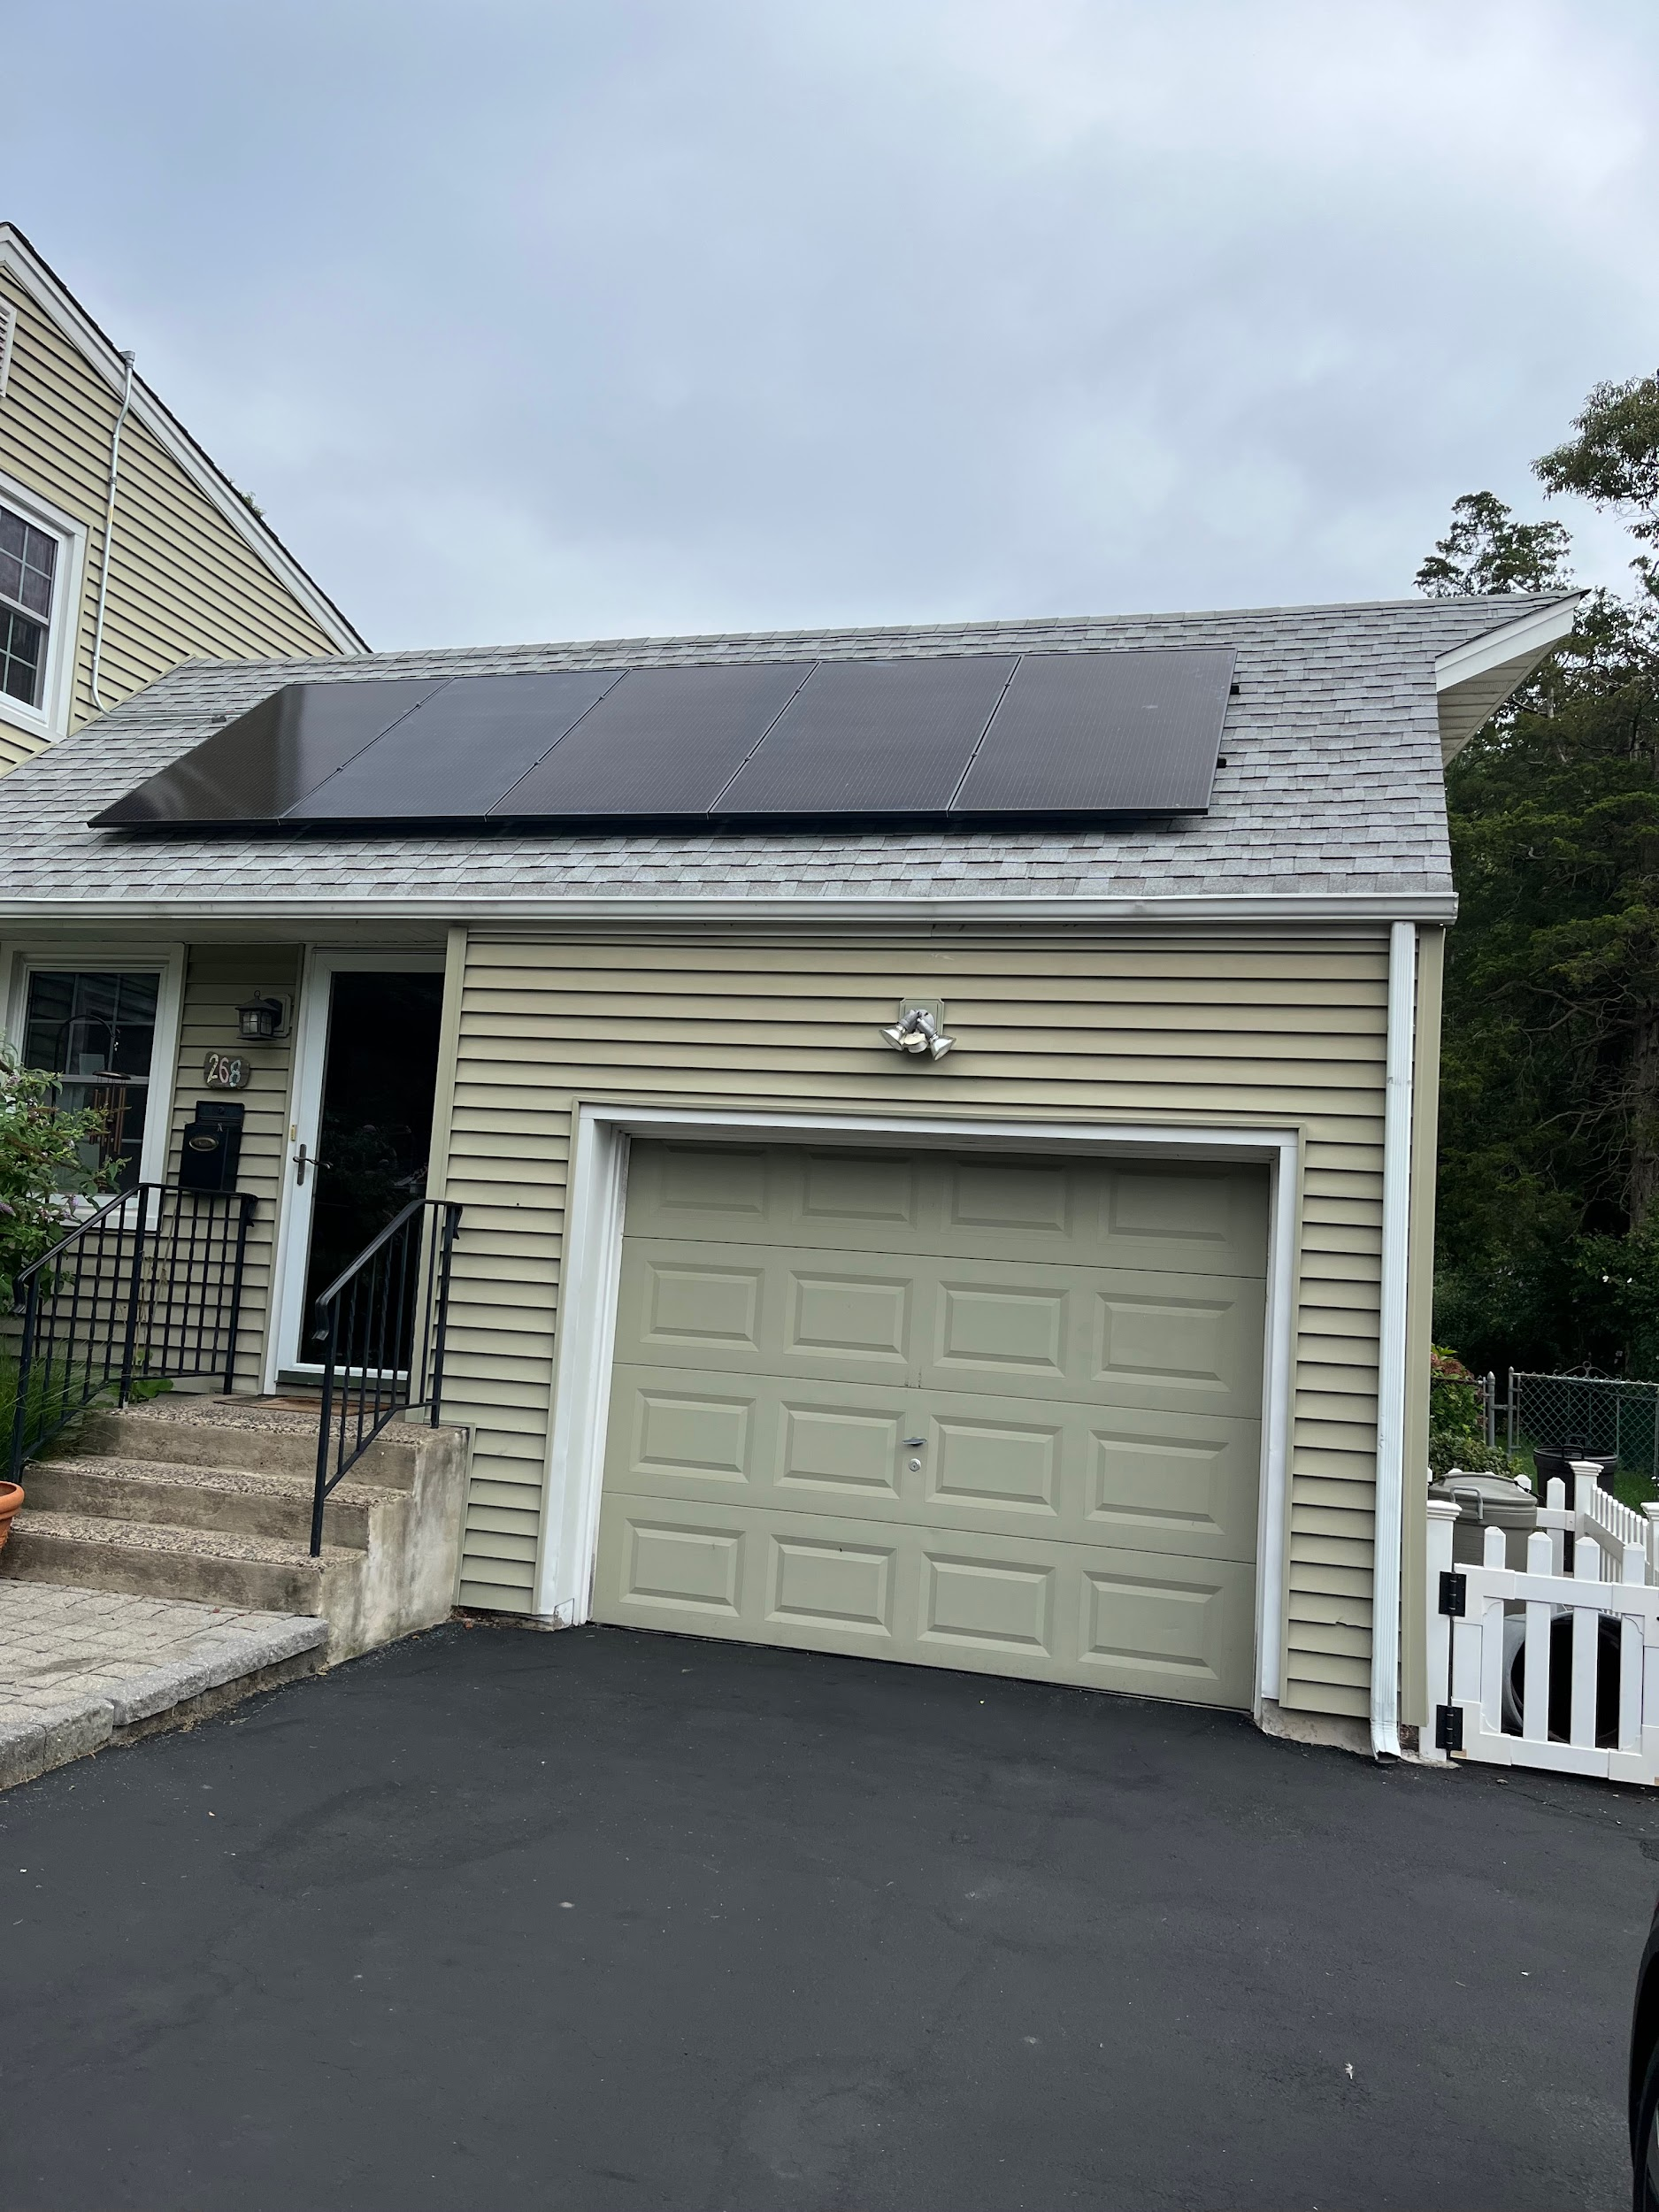
After
Notes:
#9. Years ago solar panels were thick and bulky.. No longer …ENPHASE they are dark grey and sleek! Remember the maple tree in the front yard….. The first solar company I interviewed told me it had to be removed. But the company that I chose said the tree could remain. Yea - saved a tree!!
This is an involved job - The solar engineers are the ones responsible for coming up with the size and placement of these panels in order to obtain the maximum efficiency.
My neighbor and I had the engineers create a second letter of support for front panel placement based on where the panels were being used And then the final placement approval went through. There were NO changes to the engineer’s original plans.

Slide 11
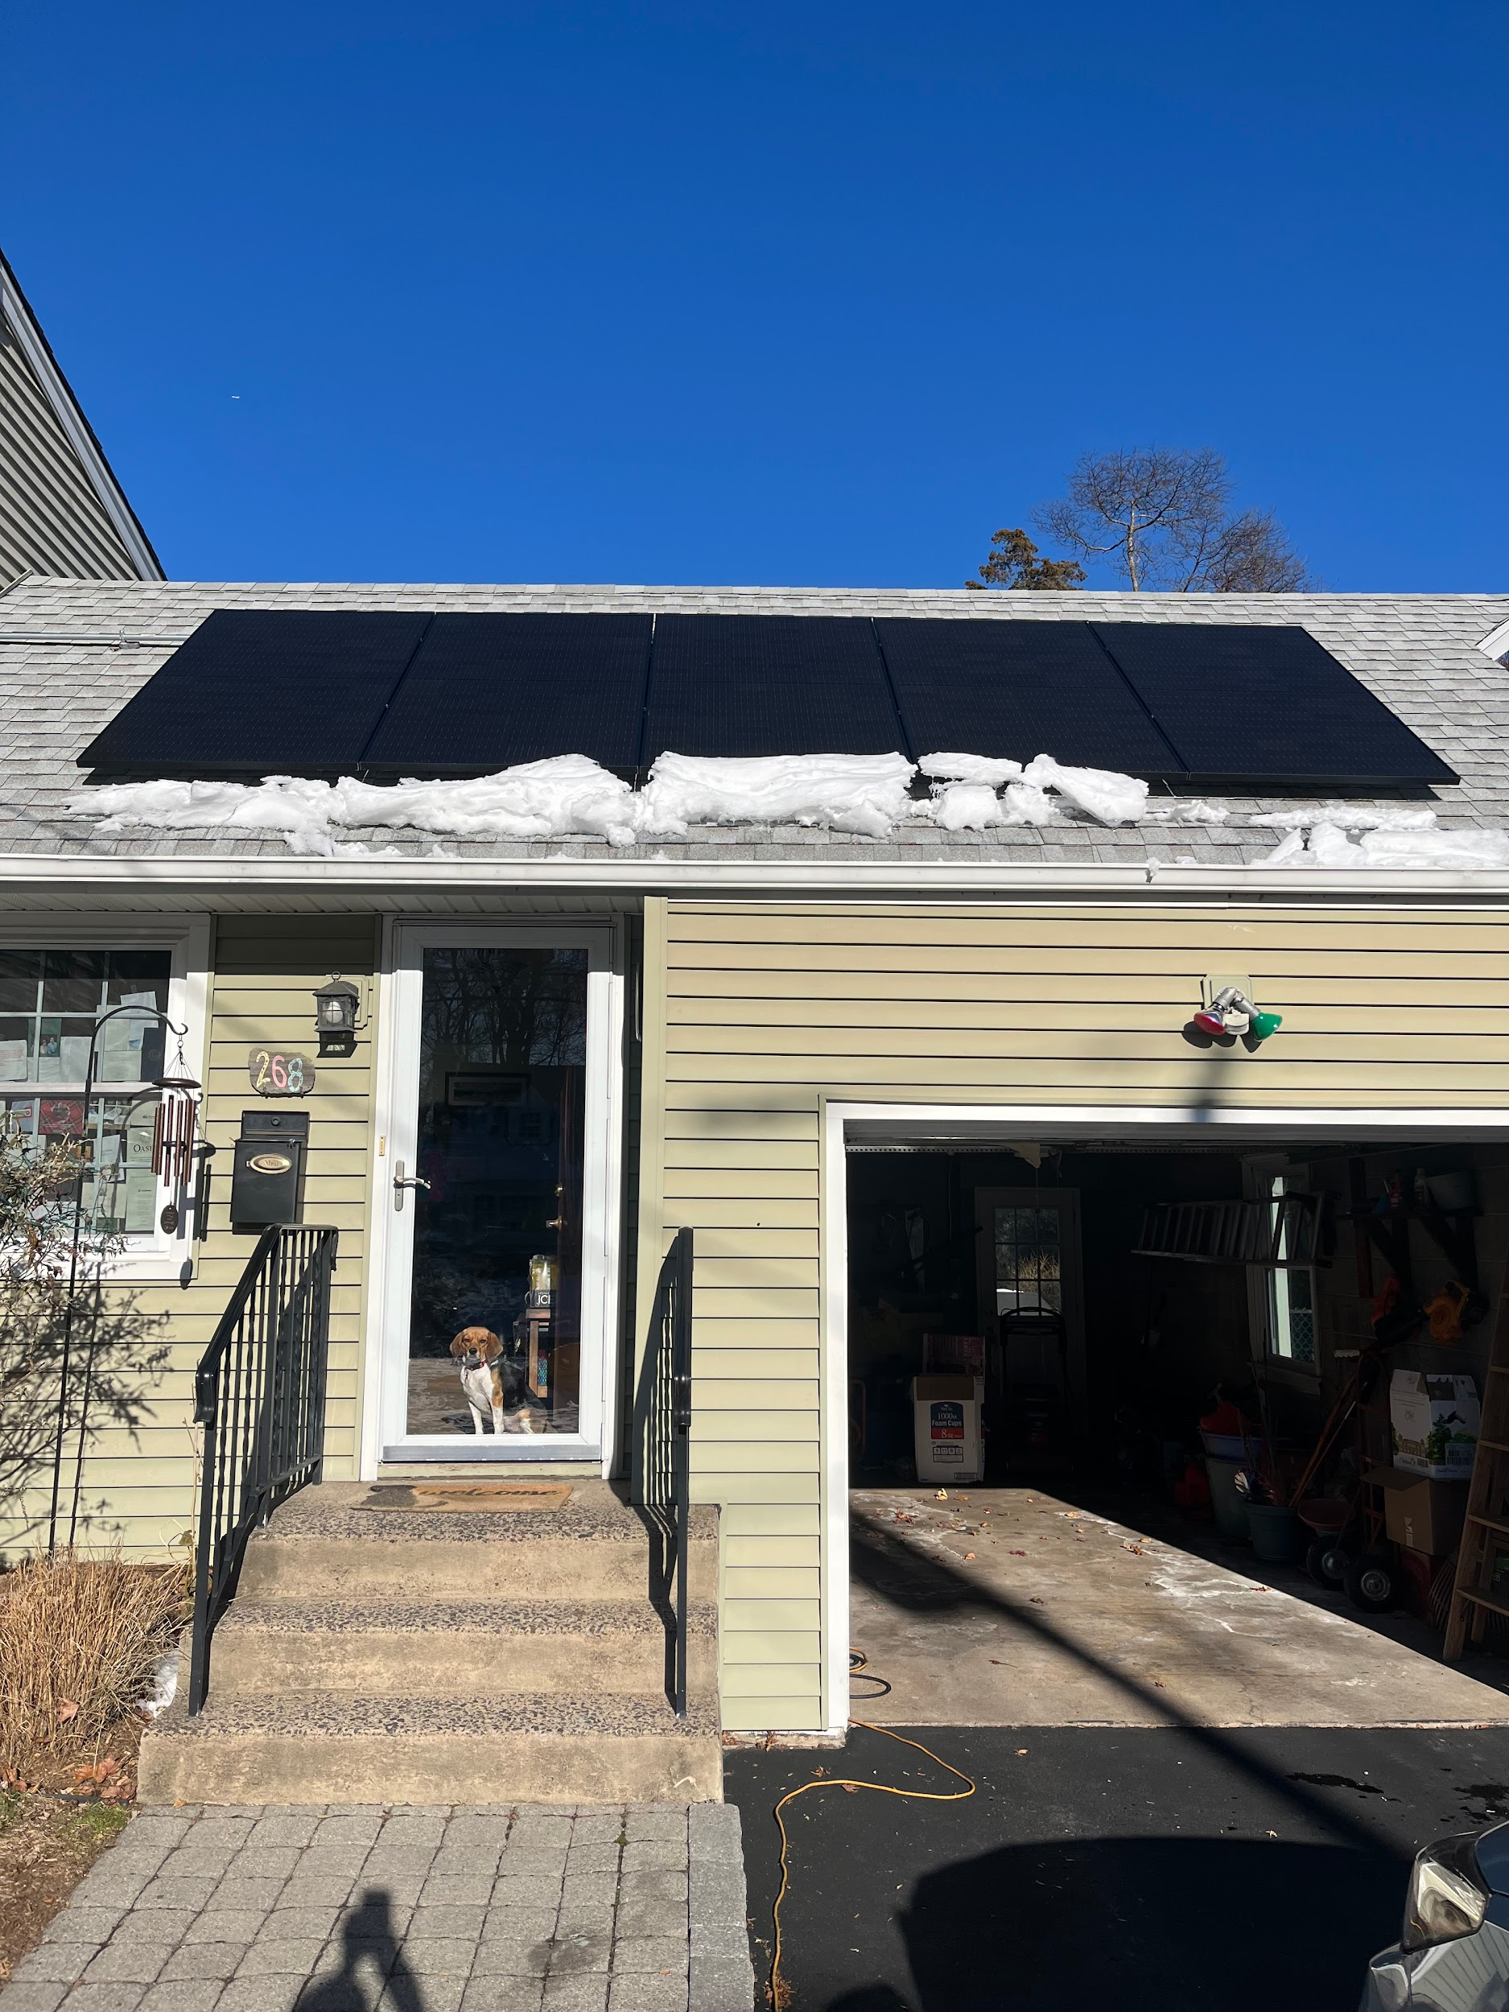
And it will even melt some snow in the winter!
Notes:
#10. These solar panels are guaranteed for 25 years for parts and labor. They are somewhat warm as there is electricity being generated inside of it. But it is NOT hot by any means. When you attach the direct sunlight onto the roof one would expect the snow to melt and slide downways!

Slide 12
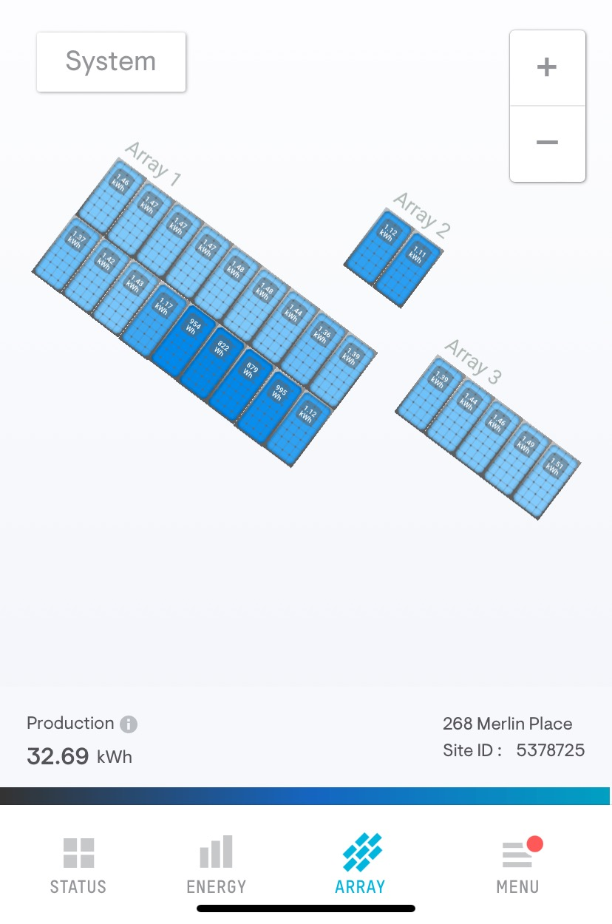
Enphase solar panels: Watch live on your phone…….
Panel by panel monitoring in real
Time. 25 panels in all.
Notes:
#11. A new type of solar panel was installed - which monitors each panel individually - 25 panels in total on our house. It’s interesting that you can watch the panels individually on your phone. Actually watch the electricity live. Also if there is a problem with the system, each panel is installed individually so you can see right away where the problem is verses a system without that feature .
Darker panels are producing less electricity. In this case they were being shaded by that maple tree. There was a shading assessment in the beginning and panels and locations worked out then. What type you get depends on the system the company is using.

Slide 13
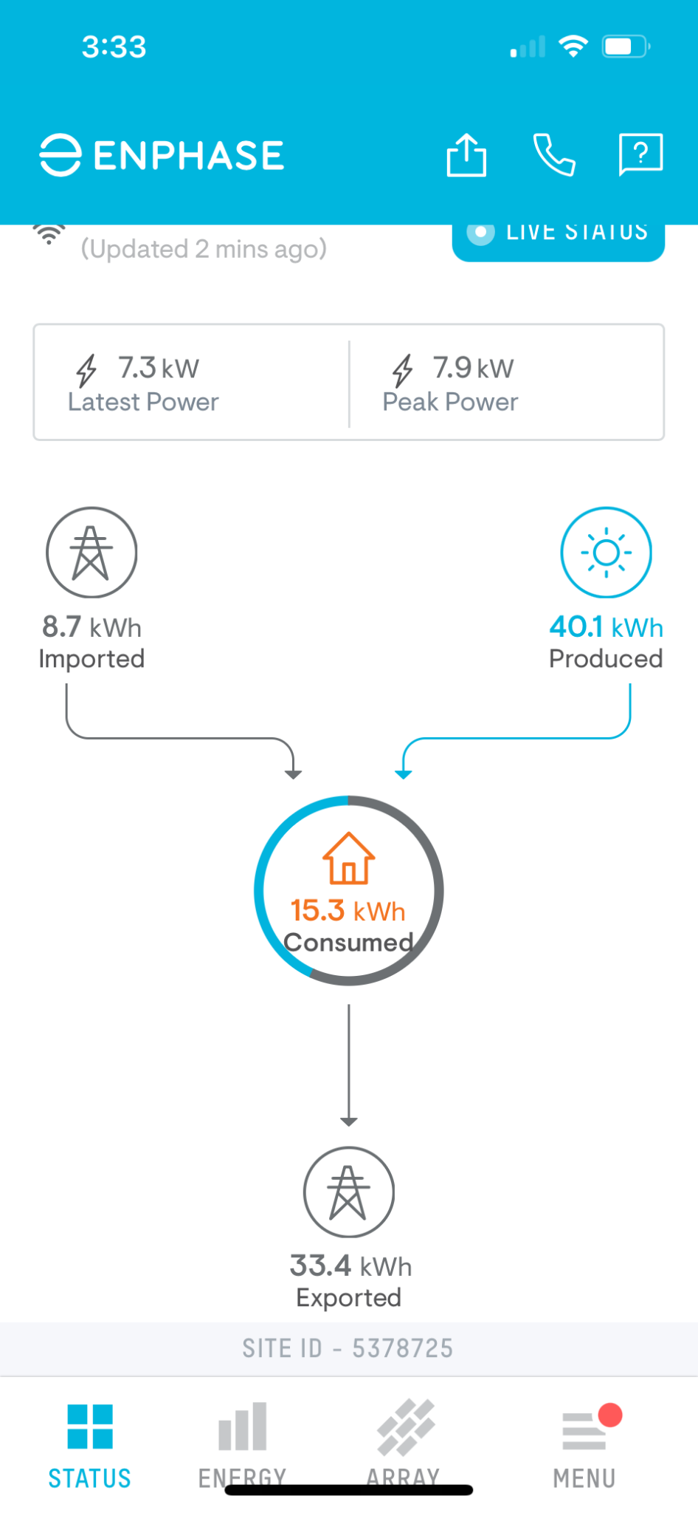
Notes:
#9. You can watch where the electricity is going in real time on your phone.
And see what each panel is doing individually.

Slide 14
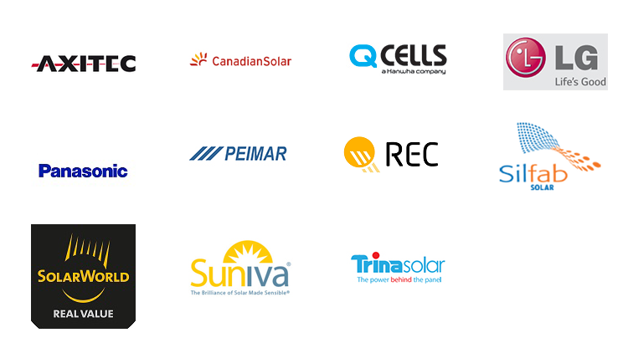
How do you decide on a solar company?
Over 260 solar companies in New Jersey!
#1 - Ask your neighbors and friends who have solar panels for their experience.
Investigate several companies - don’t go for the first one! (over 260 in the state).
Keep a list of questions as you interview them, to get answered now or later.
Go for a company who has an office in the state, and VISIT it if possible.
Notes:
13. Ask your neighbors and friends who have solar panels for their experience. Investigate several companies - don’t go for the first one. There are over 260 solar companies in the state of NJ. My company (GPE) in business since 2009 (16 years), had an office in the state, easy to communicate with, and was highly ranked by the watchdog company… Keep a list of questions as you interview the companies. Go for a company that has an office in the state. Disreputable companies exist - be careful! Use a watchdog company to compare the solar companies you are interested in, side by side, BEFORE YOU CHOOSE ONE.

Slide 15
Comparing them is much easier using a company that does it for you!
“A platform for comparison solar shopping”
There are companies that will evaluate the area where you live; offer you the names, and you make the contacts. They work with you as you choose where to go, especially with questions you don’t have answered by the salespeople.
They will investigate the companies claims
Do they have these accreditations?: Enphase gold Installer, Top solar contractors, NABCEP Board Certified by the North American Board of Certified Energy Contractors
BBB (Better Business) ratings
Business history (length of time in business - how solid is this company?)
Any complaints?
Notes:
14. Comparing……………………..Watchdog companies do NOT sell or install solar panels.

Slide 16
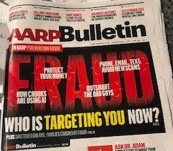
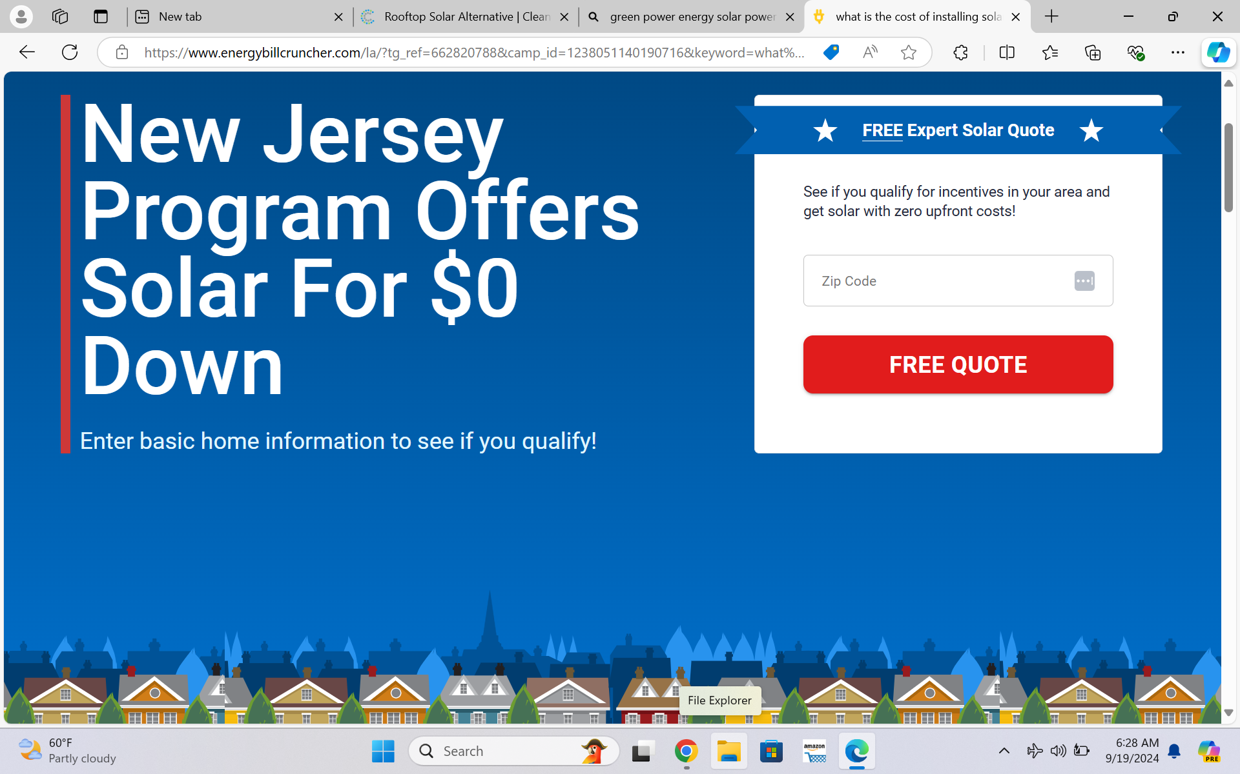
Most common scams……
often targeting retired couples…..
Pressuring retired couples to make fiscal choices without all the facts…(leases)
Make sure you thoroughly review each company
Don’t sign anything till you get multiple companies evaluated….
NOTHING IS FREE!
Notes:
15…………….

Slide 17
So how much does it cost, and how do you pay for your solar project? It depends…..
How long are you planning to live in your home? How big is your house?
Roof needs to be inspected and any repairs need to be made before placing any solar panels. Could increase your costs significantly.
Do you need to prune or remove any trees?
Common ways to pay for solar: Loan, lease, purchase…. The biggest monetary benefits come from directly purchasing your solar plan.
Notes:
16. IT depends… at least 3 different things to be considered. Biggest benefits come to you if you purchase the project. You get the federal tax rebate (30%)

Slide 18
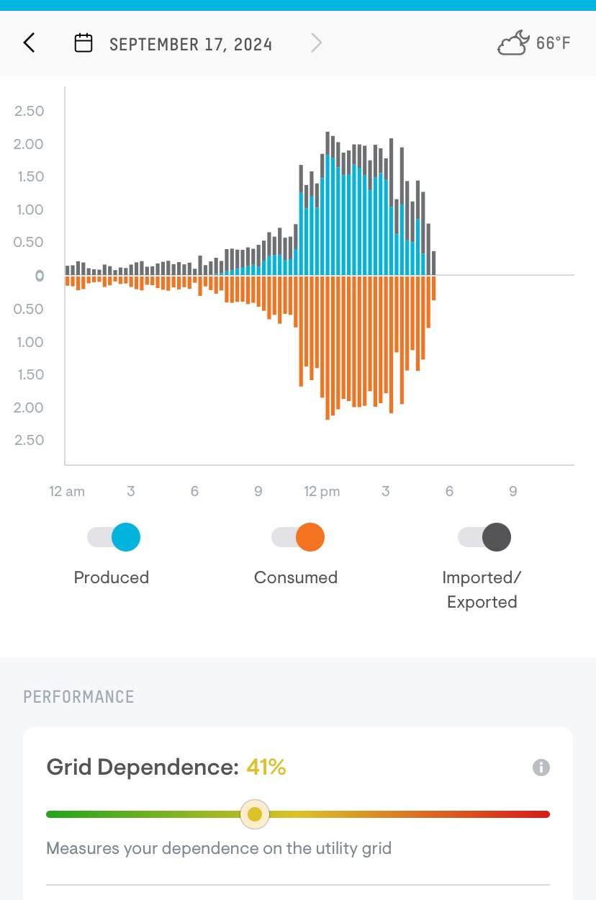
Financial benefits - start with
net metering….
A billing mechanism set up by the utilities, which offers a credit to customers who are making excess electricity with their solar panel system.
Excess energy is sent back to the grid and the amount is monitored by a meter. The credits offset your bill when sunlight is low in the winter.
Could result in a significant monetary benefit to you the homeowner.
Notes:
17. Lets look at the financial benefits - we will first address NET METERING. The Excess electricity gets saved and credited to you, and, when you aren’t capturing much, your energy can come “out of the nest”

Slide 19
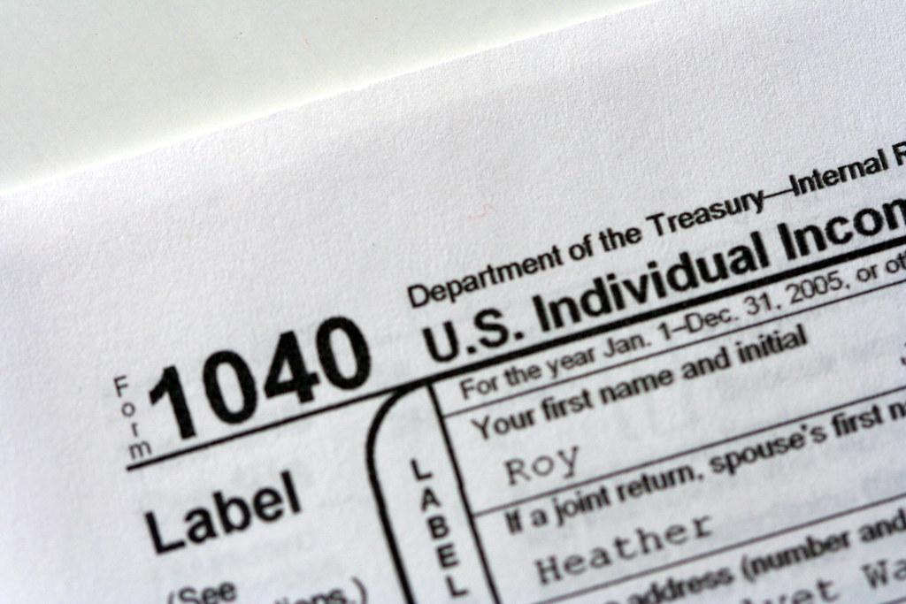
Benefits of purchasing solar energy in New Jersey
Net metering - if customer is creating excess energy it can be monitored by a bidirectional meter and sent back to the grid to use when sunlight is in short supply
Federal tax credits - 30% lowering of next yearly federal tax bill if you purchase the system (offer in place X 8 more years). You received 30% off of your federal tax bill
No NJ Sales tax (7%) for the purchase of all the equipment. (currently no deadline)
No added property tax for homeowner ever
Solar renewable energy certificates
Notes:
18. Other Financial Benefits to home owners besides net metering include….

Slide 20
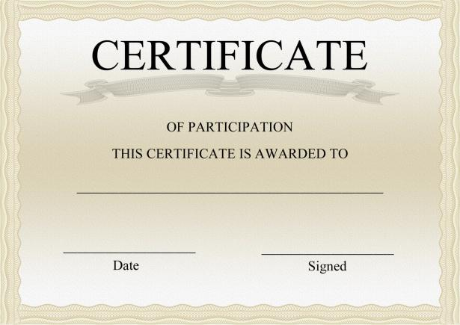
Solar renewable energy certificates…..
for companies/utilities who want to
participate in clean energy programs!
For every 1000 KW’s the homeowner generates, you can post and sell them through the NJ clean energy program marketplace….When you reach 1000 KW in storage, someone (eg a company or utility) can purchase that certificate and you receive $85 at the first of the next month. (long term program)
Notes:
19. This is for a company wants to be labeled as being green -They can do that without having produced electricity themselves, by buying the electricity from us!! SRECs are a way to account for and encourage renewable energy production and usage. Getting signed up is a process - but you only have to do it once. You can post them the first and the 15th of the month. I have been getting the $85 checks.

Slide 21
So what happens if you deplete your nest? PSE and G continues to supply you with electricity.
Who keeps track of your SREC’s? - either you do it yourself or you hire for someone to do it for you.
What did my electricity cost since I got hooked up to the meter? First 3 mos - $11, $116, $34
Most important considerations when choosing a solar panel installation company? - Don’t rush, get personal recommendations and investigate comparisons on a platform ..
Notes:
20. (Questions…)

Slide 22
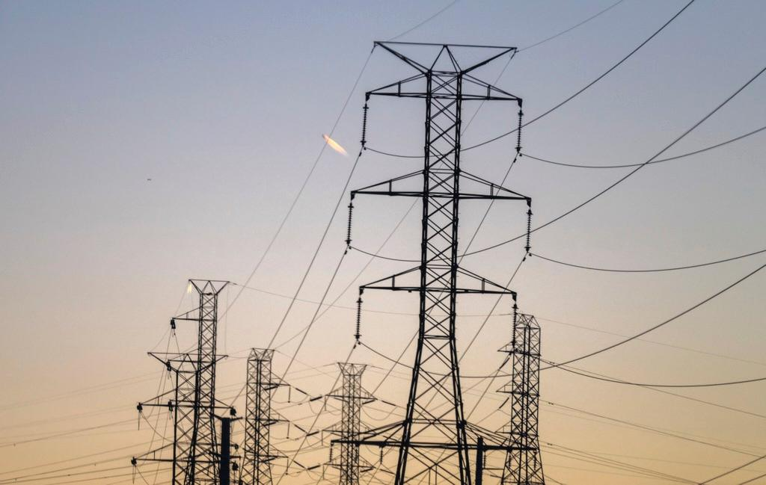
Notes:
My goal here is to show you how I navigated to the point of having an economical and environmentally sound source of electricity for our home for 25 years or more. (Solar panel parts and labor– guaranteed for 25 years!) I am focusing on solar panels as a way of saving money, as the cost of electricity is going up and up. It should be a high return on investment, meaning that the amount I will save in a few years will more than equal the cost of my system..

